Slide 1






Knowledge Graph Completion Part 1: Introduction
Fatiha Saïs ⁽¹⁾
Nathalie Pernelle⁽¹⁾
Danai Symeonidou⁽²⁾
⁽¹⁾ Lri, Paris Sud University, CNRS, Paris Saclay university
⁽²⁾ INRA, GaMMA team

Slide 2
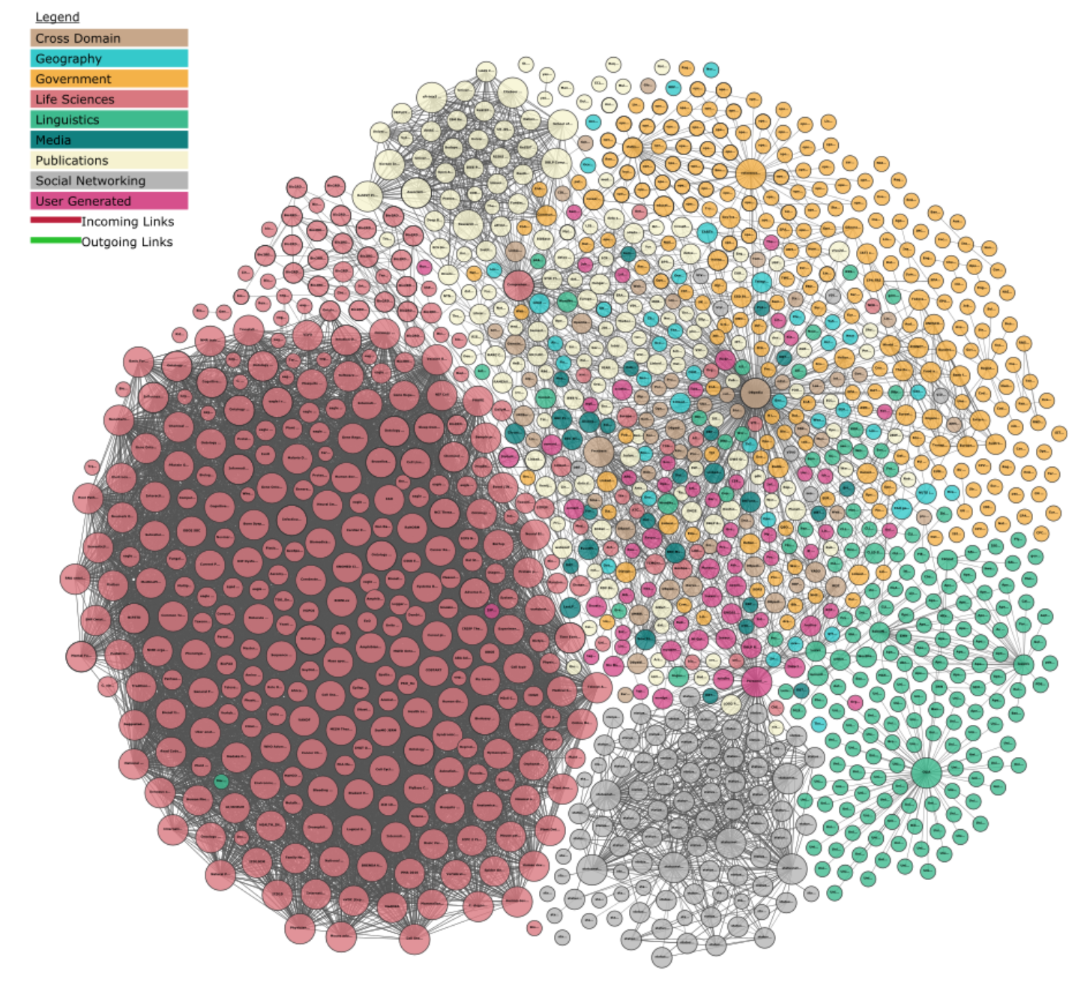

From the WWW to the Web of Data
- applying the principles of the WWW to data
Linked Open Data
data is links,
not only properties

Slide 3
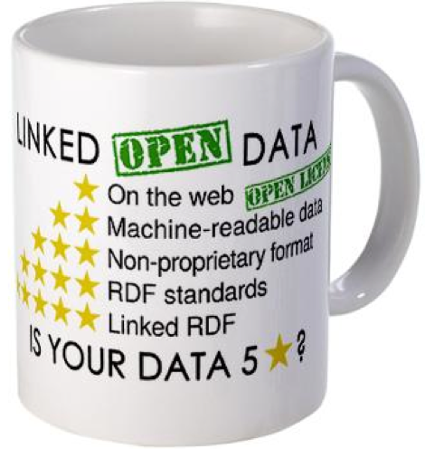
Linked Data Principles
Use HTTP URIs as identifiers for resources
→ so people can look up the data
Provide data at the location of URIs
→ to provide data for interested parties
Include links to other resources
→so people can discover more things
→bridging disciplines and domains
➔ Unlock the potential of island repositories
Tim Berners Lee, 2006
Notes:
Open the data using open licences
Give RDF data on the object of the HTTP URI

Slide 4
RDF – Resource Description Framework
Statements of < subject predicate object >
http://dbpedia.org/resource/Airbus
dbo:name
“Airbus”
Subject
Predicate
Object
… is called a triple

Slide 5
Linked open Data
Linked Data - Datasets under an open access
1,139 datasets
over 100B triples
about 500M links
several domains
Ex. DBPedia : 1.5 B triples
"Linking Open Data cloud diagram 2017, by Andrejs Abele, John P. McCrae, Paul Buitelaar, Anja Jentzsch and Richard Cyganiak. http://lod-cloud.net/"

Slide 6
Need of knowledge

Slide 7
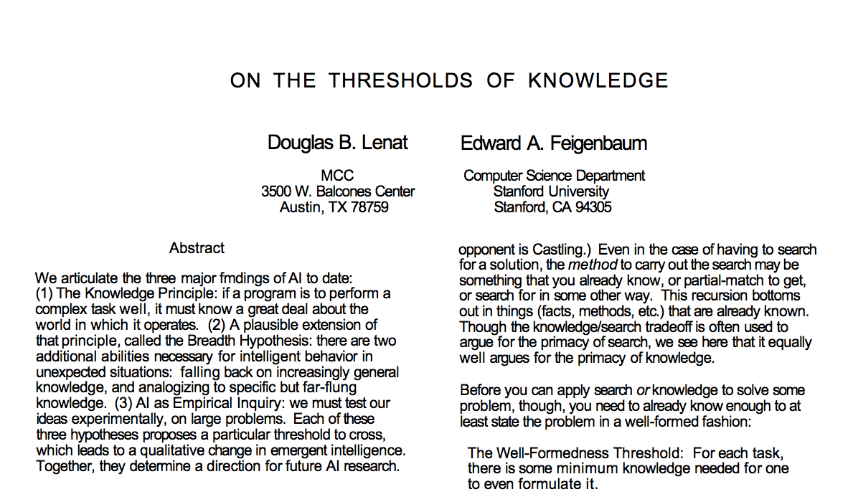
The role of knowledge in AI
[Artificial Intelligence 47 (1991)]
The knowledge principle: “if a program is to perform a complex task well, it must know a great deal about the world in which it operates.”
Notes:
1) Le principe de la connaissance: «si un programme doit bien accomplir une tâche complexe, il doit en savoir beaucoup sur le monde dans lequel il opère».
2) L'hypothèse de la largeur: «Il y a deux capacités supplémentaires nécessaires pour un comportement intelligent dans des situations inattendues: se replier sur des connaissances de plus en plus générales, et assimiler à des connaissances spécifiques mais éloignées»
far-flung knowledge : connaissance lointaine

Slide 8
Ontology, a definition
“An ontology is an explicit, formal specification of a shared conceptualization.”
[Thomas R. Gruber, 1993]
Conceptualization: abstract model of domain related expressions
Specification: domain related
Explicit: semantics of all expressions is clear
Formal: machine-readable
Shared: consensus (different people have different perceptions)
Notes:
l'ontologie est une spécification explicite et formelle d'une conceptualisation partagée

Slide 9
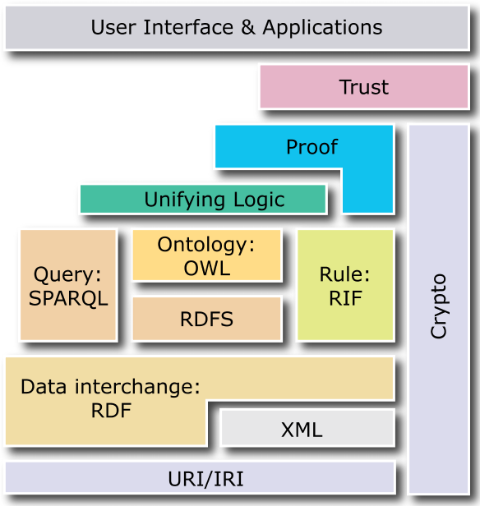
Semantic Web: Ontologies
RDFS – Resource Description Framework Schema
Lightweight ontologies
OWL – Web Ontology Language
Expressive ontologies
Source: https://it.wikipedia.org/wiki/File:W3C-Semantic_Web_layerCake.png

Slide 10
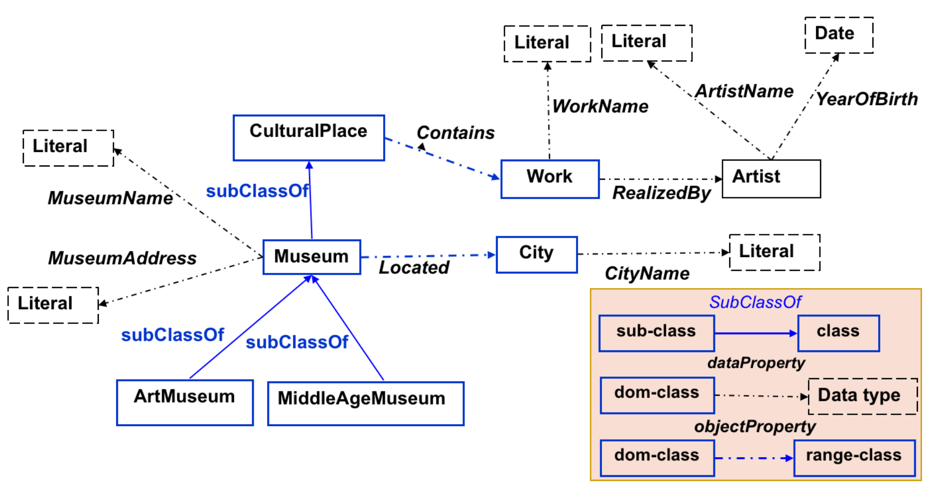
OWL ontology
Classes: concepts or collections of objects (individuals)
Properties:
owl:DataTypeProperty (attribute)
owl:ObjectProperty (relation)
Hierarchy
owl:subClassOf
owl:subPropertyOf
Individuals: ground-level of the ontology (instances)
OWL – Web Ontology Language
Represents rich and complex knowledge about things
Based on First Order Logic (FOL)
Can be used to verify the consistency of knowledge
Can make implicit knowledge explicit
10

Slide 11
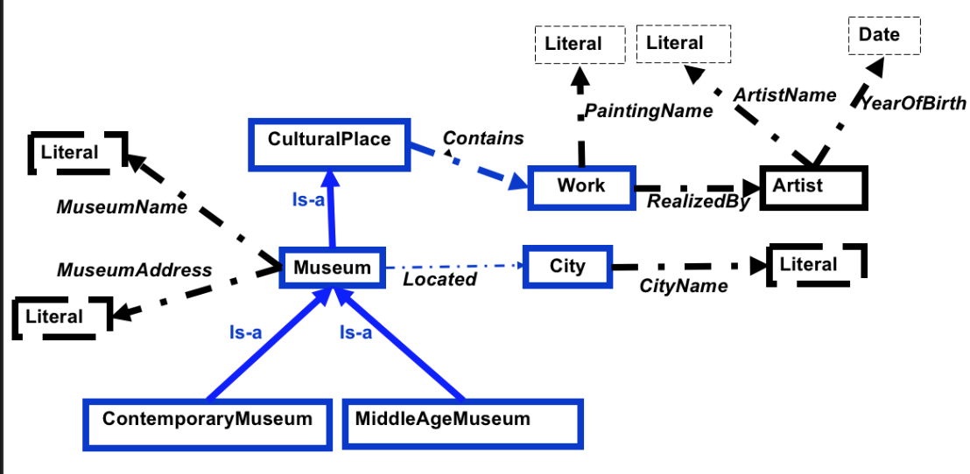
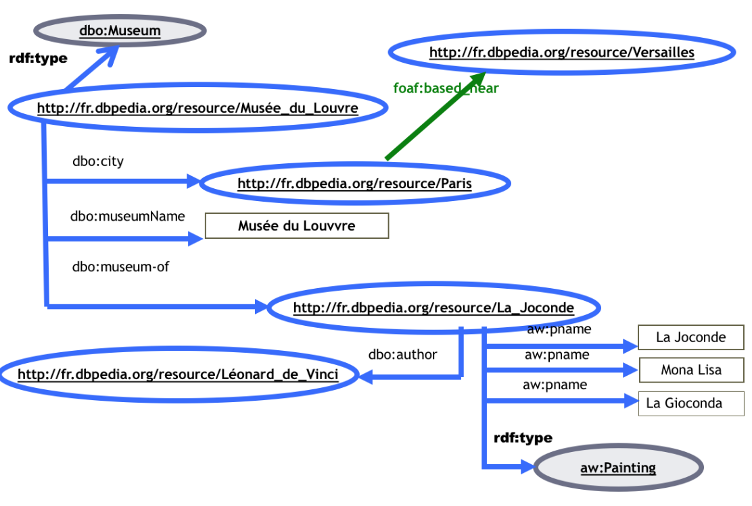
ontology levels
Conceptual level:
- classes, properties (relations)
:type
:type
:type
Instance level:
- facts (individuals)

Slide 12
OWL ontology - axioms
Axioms: knowledge definitions in the ontology that were explicitly defined and have not been proven true.
Reasoning over an ontology
→ Implicit knowledge can be made explicit by logical reasoning
Example:
Pompidou museum is an Art Museum
< Pompidou_museum rdf:type ArtMuseum> .
Pompidou museum contains Hallucination partielle
< Pompidou_museum ao:contains Hallucination_partielle> .
Infer that:
Pompidou museum is a CulturalPlace
< Pompidou_museum rdf:type CulturalPlace> .
Because: Museum subsumes ArtMuseum and CulturalPlace subsumes Museum
Hallucination partielle is a Work
<Hallucination_partielle rdf:type ao:Work> .
Because: the range of the object property contains is the class Work.
12

Slide 13
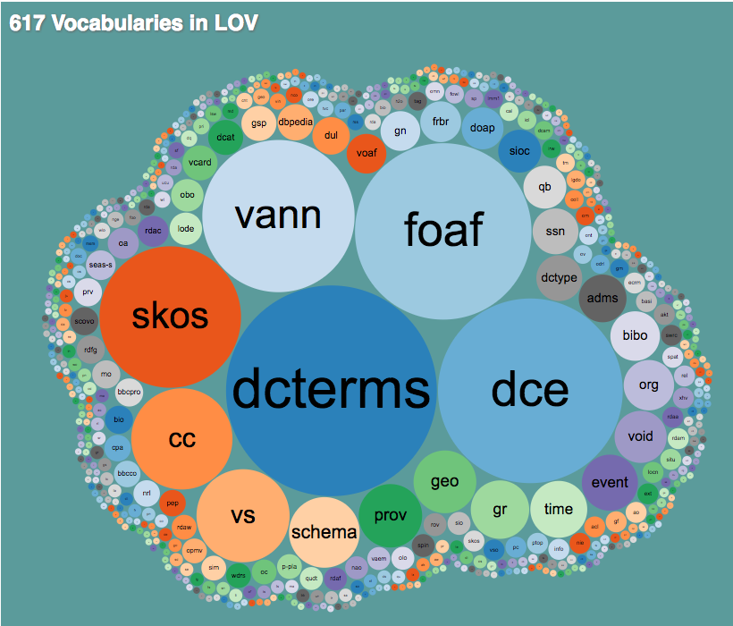
Linked Open Vocabularies (LOV)
Linked Open Vocabularies
Keeps track of available open ontologies and provides them as a graph
Search for available ontologies, open for reuse
Example:
http://lov.okfn.org/dataset/lov/vocabs/foaf

Slide 14
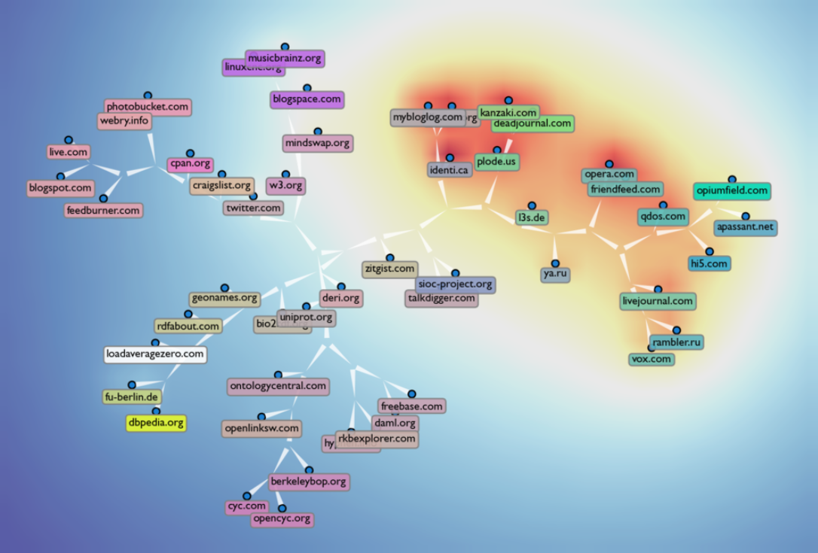
Ontology predicates Spread on the Semantic Web
RDFa (or Resource Description Framework in Attributes)
Top 50 web sites publishing Semantic Web data, clustered by predicates used.
FOAF

Slide 15
Outline
Linked Open Data
Knowledge Graphs
Technical Part
Data Linking
Key Discovery
Link Validation
Conclusion and Future Challenges

Slide 16
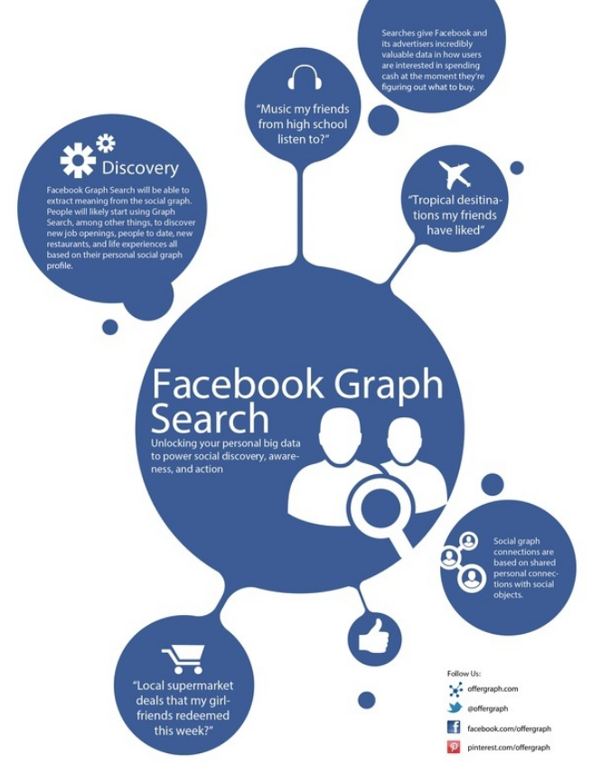

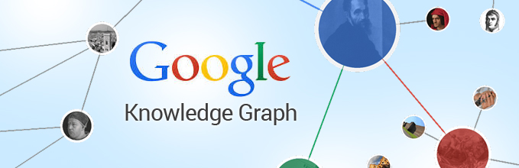
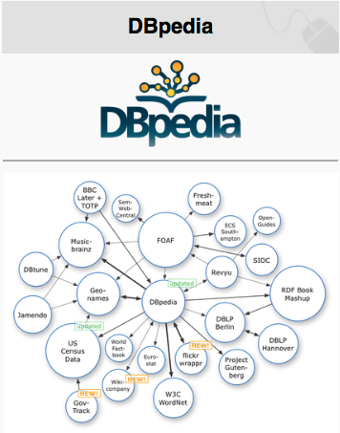

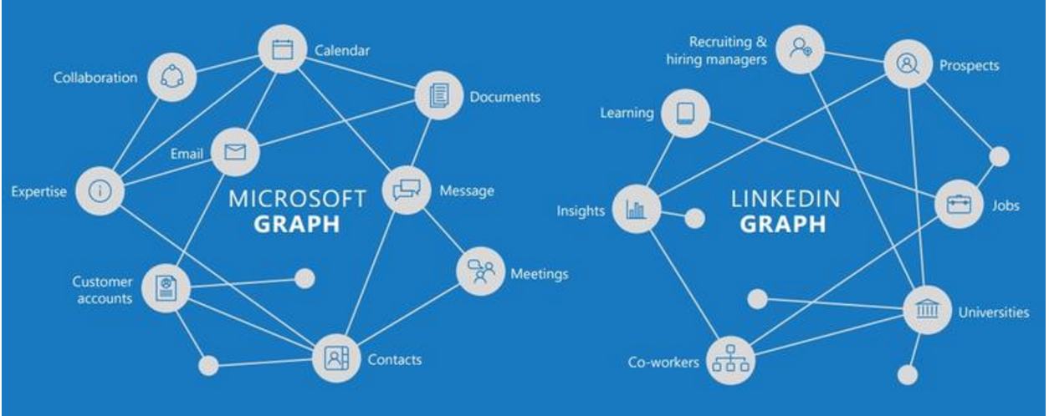


Who is developing knowledge graphs?
2013
2012
2007
2008
2012
2015
2016
2007
2013
Academic side
Commercial side

Slide 17
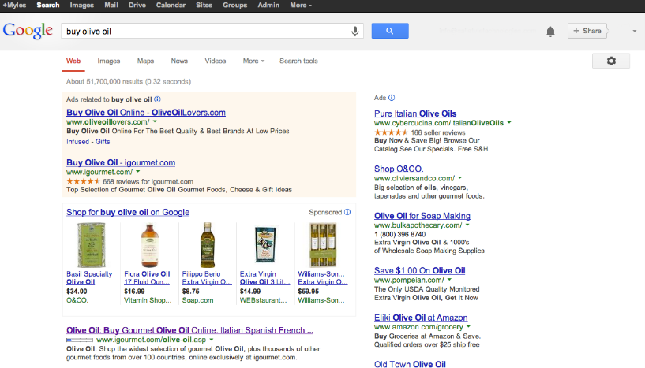
Web search without knowledge graphs

Slide 18

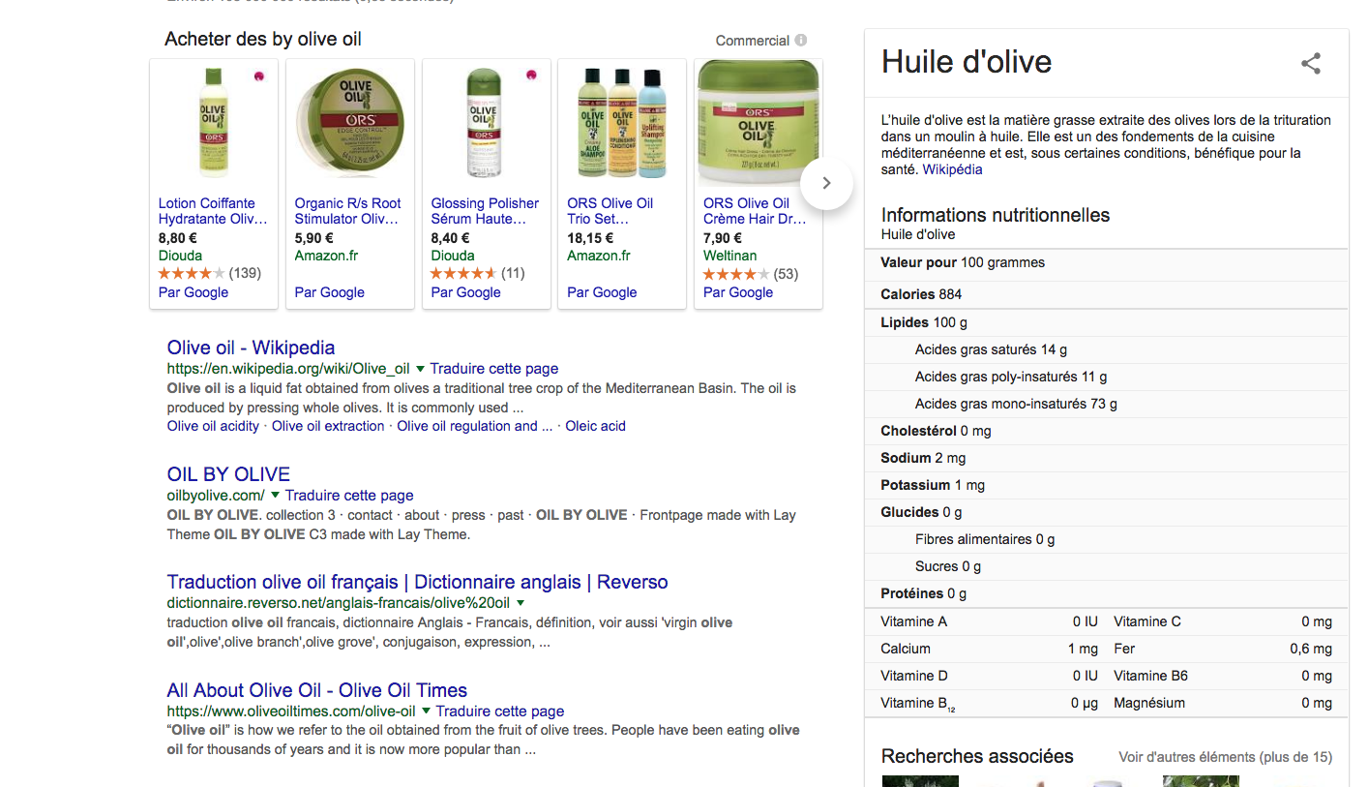
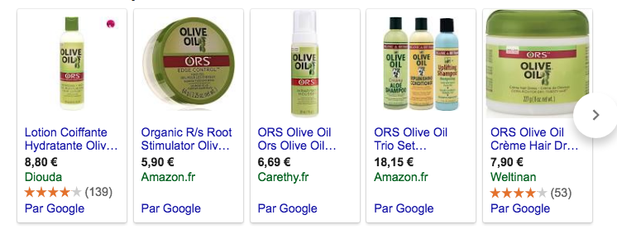
Web search with knowledge graphs

Slide 19
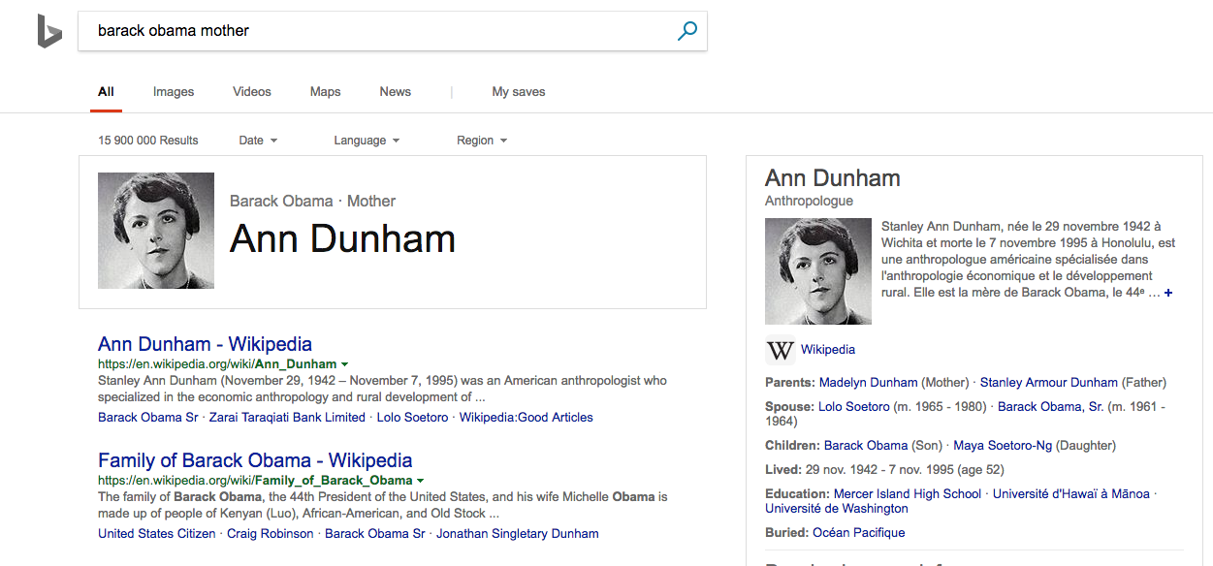
Question answering with knowledge graphs

Slide 20
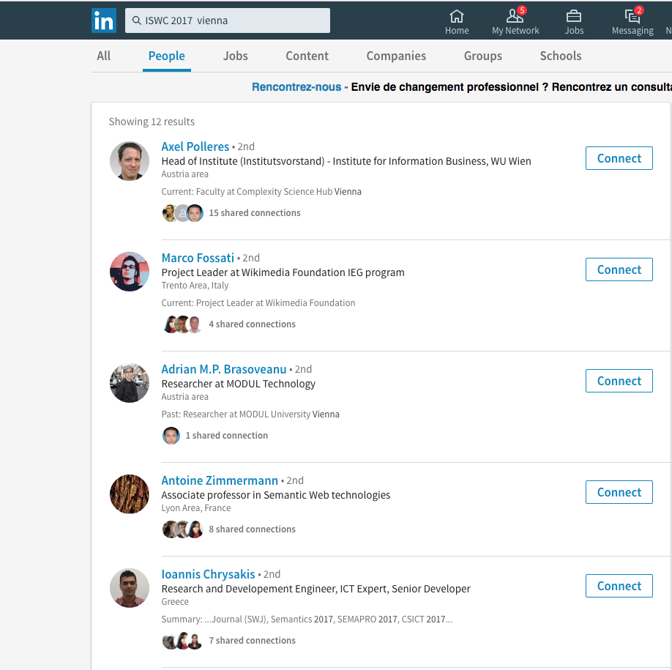
Connecting events and people with knowledge graphs

Slide 21
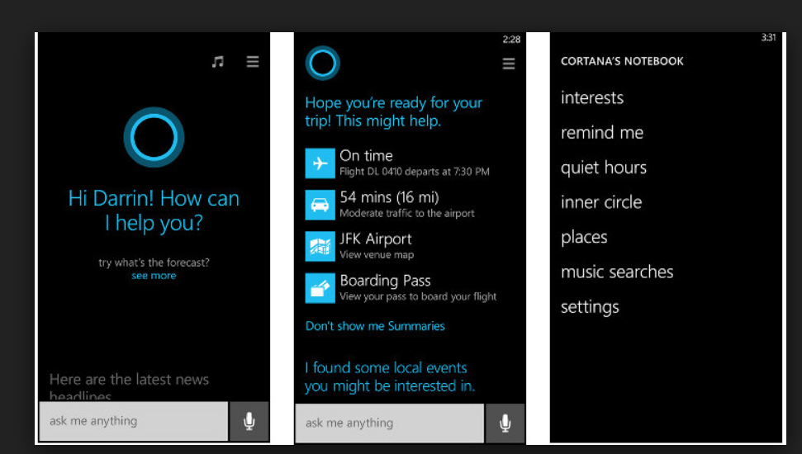
Towards a knowledge-powered digital assistant
Cortana (Microsoft)
Natural access and storage of knowledge
Chat bots
Personalization
Emotion

Slide 22
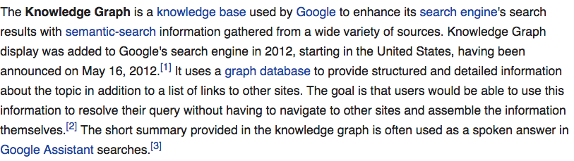
knowledge graph: a definition …
Wikipedia (en)
This is not a formal definition!

Slide 23
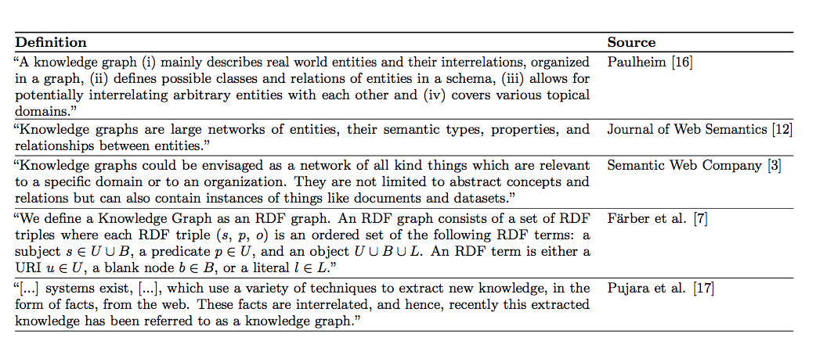
knowledge graph: a definition …
[L. Ehrlinger and W. Wöß, SEMANTiCS’2016]
Populated
Ontology
RDF Graph
Populated
Ontology
RDF Graph
Extracted
RDF Graph
[3] A. Blumauer. From Taxonomies over Ontologies to Knowledge Graphs, July 2014. https://blog.semanticweb.at/2014/07/15/from-taxonomies-over-ontologiesto-knowledge-graphs [August, 2016].
[12] M. Kroetsch and G. Weikum. Journal of Web Semantics: Special Issue on Knowledge Graphs. http://www.websemanticsjournal.org/index.php/ps/ announcement/view/19 [August, 2016].
[7] M. Farber, B. Ell, C. Menne, A. Rettinger, and F. Bartscherer. Linked Data Quality of DBpedia, Freebase, OpenCyc, Wikidata, and YAGO. Semantic Web Journal, 2016. http://www.semantic-web-journal. net/content/linked-data-quality-dbpedia-freebaseopencyc-wikidata-and-yago [August, 2016] (revised version, under review).
[16] H. Paulheim. Knowledge Graph Refinement: A Survey of Approaches and Evaluation Methods. Semantic Web Journal, (Preprint):1–20, 2016.
[17] J. Pujara, H. Miao, L. Getoor, and W. Cohen. Knowledge Graph Identification. In Proceedings of the 12th International Semantic Web Conference - Part I, ISWC ’13, pages 542–557, New York, USA, 2013. Springer.

Slide 24
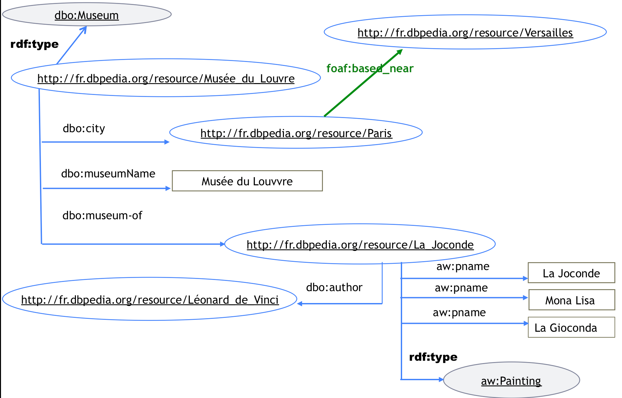
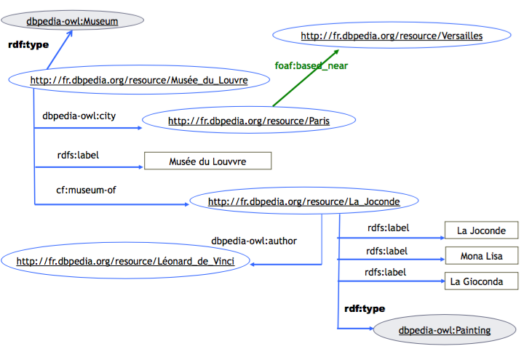
Knowledge Graph (KG)
RDF Graphs
Thing
Ontology hierarchy
is-a
is-a
dbo:Agent
is-a
is-a
dbo:city
dbo:PopulatedPlace
dbo:Person
dbo:Museum
dbo:museum-of
is-a
dbo:author
dbo:Painting
dbo:Artist
Querying (SPARQL)
Ontology axioms and rules
PREFIX dbo: <http://dbpedia.org/ontology#>
PREFIX rdf: <http://www.w3.org/1999/02/22-rdf-syntax-ns#>
SELECT ?m ?p
WHERE { ?m rdf:type dbo:Museum . ?m dbo:musuem-of ?p .}
owl:equivalentClass(dbo:Municipality, dbo:Place) owl:equivalentClass(dbo:Place, dbo:Wikidata:Q532)
owl:equivalentClass(dbo:Village, dbo:PopulatedPlace)
owl:equivalentClass(dbo:PopulatedPlace,dbo:Municipality)
owl:disjointClass(dbo:PopulatedPlace, dbo:Artist) owl:disjointClass(dbo:PopulatedPlace, dbo:Painting)
owl:FunctionalProperty(dbo:city)
owl:InverseFunctionalProperty(dbo:museum-of)
dbo:birthPlace(X, Y) => dbo:citizsenOf(X, Y)
dbo:parentOf(X, Y) => dbo:child(Y, X)
Reasoners: (Pellet, Fact++, Hermit, etc. )
KG saturation: infer whatever can be inferred from the KG.
KG consistency checking: no contradictions
KG repairing
…

Slide 25
knowledge graph expansion and enrichment
Expansion: knowledge graphs are incomplete
Data linking (entity resolution, reference reconciliation, …)
Link prediction: add relations
Ontology matching: connect graphs
Missing values prediction/inference
Enrichment: can new knowledge emerge from knowledge graphs?
Knowledge discovery: Key discovery
Automatic reasoning and planning
Validation: knowledge graphs may contain errors
Link Validation
Dealing with errors and ambiguities

